Slide 1
Garden of eden
Stewardship engineering pedogogi scripture

Slide 2
• Or one should use caution to respect dependably the ritual characteristics of the covenant of the Law: circumcision, the sabbath, the rules of the pure / impure …
Justification by grace
As the Reformers will rediscover it 15 centuries after Paul, the sinner is justified by grace alone, in response to faith alone, on the only basis of the righteousness of Christ.
15 centuries of religious dust had masked and disfigured the Gospel into a theory of salvation in step with human conceptions,. Il’s a way that man will notice in himself, in nature or in some ancient religion.
The gospel preached by Paul doesn’t come from man, it is a revelation from God. It’s salvation in steps with God’s standards. Or as Luther says, it is justice that’s price (that has value) before God.
This way of salvation isn’t an choice among several others, it’s the sole possible one. If there were others, why would God the Father have accepted that his Son ought to die on a cross?
3. How will this power work? The world will be inspired to by the binary implementation
Or to formulate the question differently:
sins.

Slide 3
Abstract
How can the Gospel change the heart, how can we understand this righteousness of God?
justification et sanctification, lettre aux Romains,LutherMartin Luther and Romans 1.18
A verse terribly simple to understand is Romans 1.18. But it is terrific. God is right, that’s for sure, but I have no solution, no answer in myself.
Martin Luther struggled during this dramatic blockade for 7 years in his convent.
Then, whereas making ready a course of theology, he had an enlightenment.
The justice of v. 17, determinant for salvation, it is not the penal justice that God inflicts on the sinner and which the sinner can never satisfy.
It is the righteousness of the law that Jesus perfectly accomplished and that God freely offers to the sinner who believes that by welcoming him, God offers him grace. In other words, the sinner doesn’t ought to urgently look for what he might supply God in payment for his sins.

Slide 4
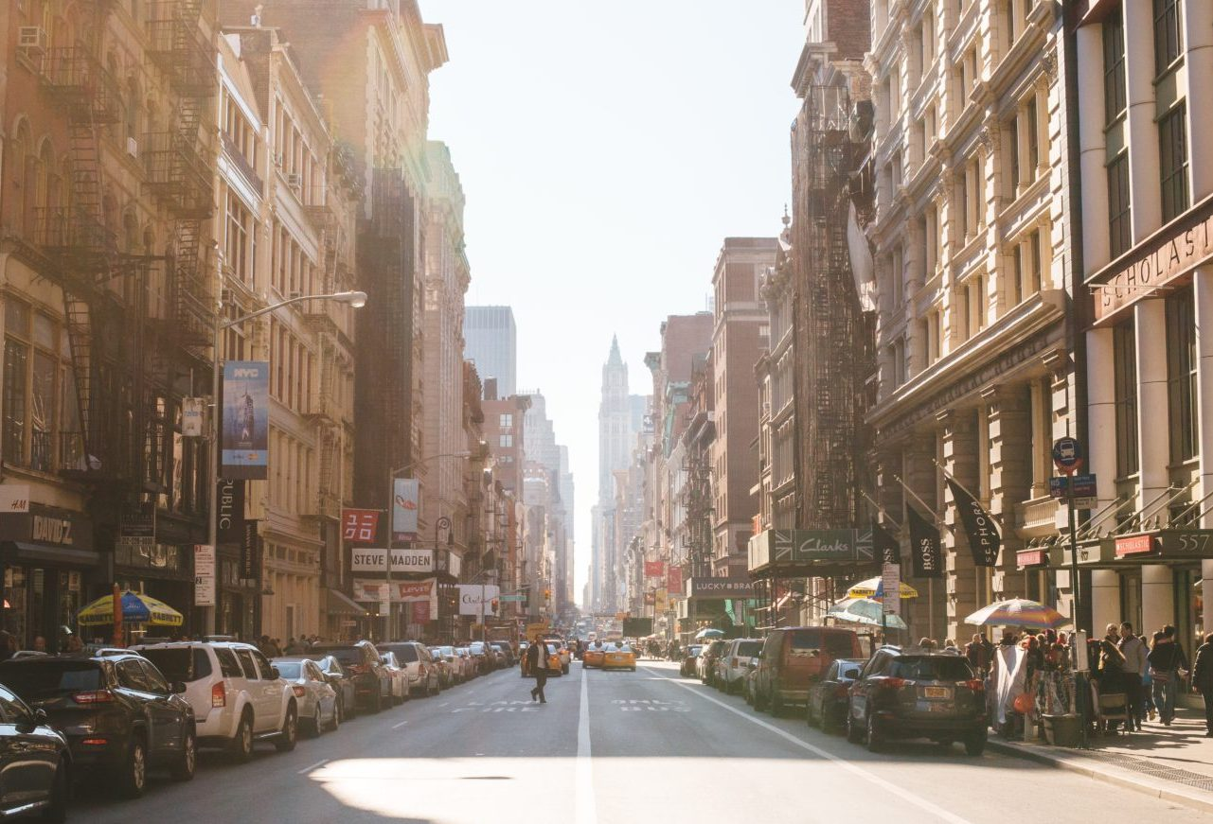
Garden of eden
Collective diochamy of human species, polynomer to productivity create in a special way and interact on that data and analysis portfolio in that tradjectory,longtitude from the ecological diversity of animal,world,human neibour in survival/exsistence crisis of abstract, to resonate with life’, purpose of ecologic lifesystem impetus.

Slide 5
Merge with life
Planning evolution emancipation of world lifeform creation . Creation architectural precision, capture compiles to build, ‘organization ethical interpretation of progress and developedment’. Planning evolution emancipation of world lifeform creation Enterprise growth from collective ‘reparainchen’ of stewardship architecture data/schematics .
To compile convergence page of the analysis , research invested to enshure competent delivery of payload {righteousness}. Plan of god {garden of eden} holyland/logos . ‘Enterprise architect’ Adventis logos-will of god . Jurisprudence society.

Slide 6
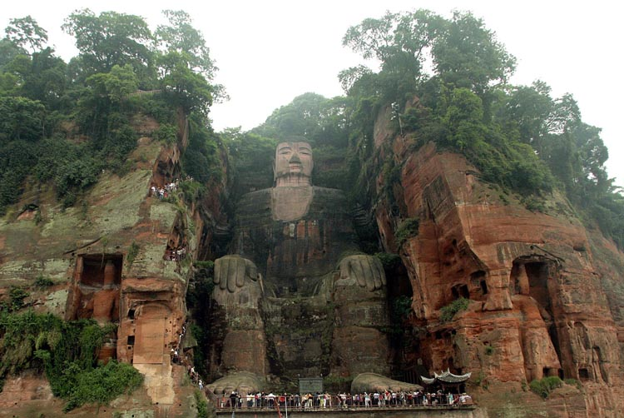
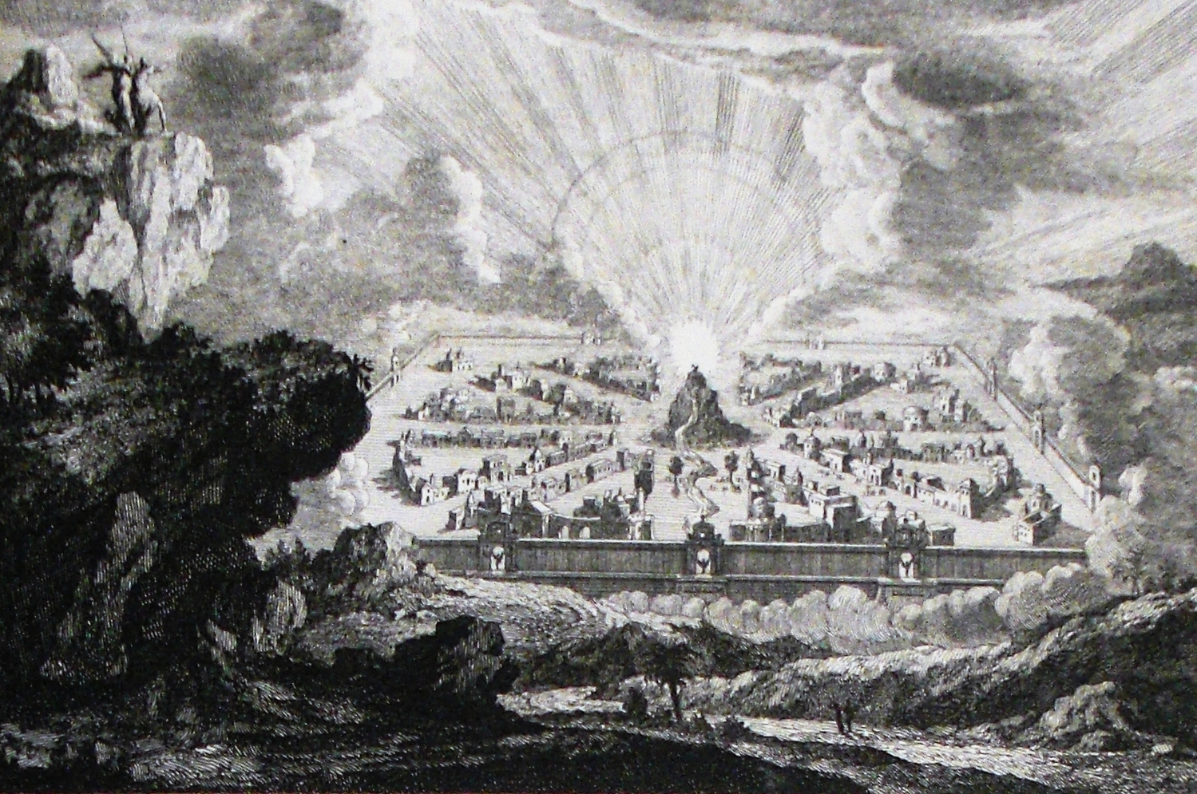
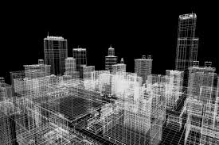
Righteousness Garden of eden
Anthropologic engineering
Conservation/Preservation

Slide 7
Designconstant
Create architecture, information biography, for horizon terminator , ideology of creation, covenant benediction, accountable creation ‘credentials-creiteria, ‘data from all fields in biography of collective ‘endeavors. To compile architectural data manuscript, ‘lifeform selfsustainance initiative, from authentication of creation statutory /lexical constants, ‘input-output’ from variable-factor ‘productive/consumption’ lifesystem cycles, ’pseudoscience-apfredesiac’. From multi-dimensional research subjects in all field of life endeavors, nodes of the interwoven {binary} society of “humanbeing species”. From ideology of “convergence” multi-dimensional purpose society of all livingthings, contributing fiscal censuses demographics of statutory regiemen on green intuition of intuitive consciousness “light array” ‘in the fields of creations life endeavors. level impetus,mechanism gametheory {socialethics} unity from individual of all species rendering allocated ‘creation mechanology, ’homage, creiteria and potencial.

Slide 8
Garden of eden
A construction of a unified road, of naturally implement equilibrium of the universe, synchronize ect. struggles of creation chronicles/chronology ethnic binary {garden variety eden}-collective binary, orientation to true form of apocalypse armeggedon ‘manuscripts. fundamental-foundation. Trending from upspring of the gardens roots to the trending growth, ‘conditioning to the ‘birth of life’ uniting the two becoming an expansion insight. Expansion insights reflect upon the entitlements of human right, ‘form factor and fit hieroglyphic,vocational-clerical voluntary grouping of algorithm, geneologic chronicles enterprise circular ‘stratedgic methodology of intuitive conciousness.

Slide 9
Garden professional variety
Doctorate of ‘society meltingpot’ manuscripts folklore, biographic manifest, manifesto. Of how the balance, equilibrium, linguistics and other educational nostalgia supported man in his need for a media to communicate and resonate with ‘astrological consciousness and visions of god’ . To had analyzed the lexical information, ritual as it had unveiled in the stages of it’s life complex multiple-dimensional, ‘anatomy’of stratedgic logic and methodology. {Programming eden prophecy} creation transformations, deity plotter/plannar’ ‘enterprise architecture of united purpose in sociology of garden/ enterprise millenia tradjectory. A new world became with All explorers and followers of creation equity of ‘ergronomic industry’ precision process productive to return in investment of intuitive reproducable ‘mentor, coaching to ‘cache intuitive compliance of graphic to capture repetition, circular i.p interaction, data/informations equitable variable-factor learning experience of services urban vocational logic/natural learning . Where civilization deteriorated morally.

Slide 10
Meltingpot culinary arts
All life endeavors are a recognized tradition of pursuit in creation endeavors of man machine work, planning, business humility of labour as an exercise contribution to equity circular impetus of ergronomic life earth purpose of life natural inhabitant to inclusion linguistic skillset methodology incubator skillset, statutory. ‘building the reasoning and understanding to intellectual inclusion to set tradjectory of probable scale-scope for the career object analysis, ‘beauty doth please the eye’ to embrace true purpose, on the connectivity ‘call to action’ stewardship inclusion manifesto’, to recite manuscript for a journal of experiencing wealth and purpose of social inclusion and “tyranny” epic proportions to save the world amongst other tradgety in the ‘Adventists schedule of the world information’to decipher collective vend diag of construction to present geographic world binary system reality.

Slide 11
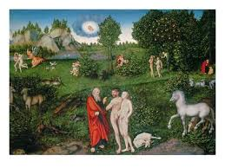
Capitalist ideologies that construct land as having a ‘use value’ have also been used to support notions of progress and development. In particular, Plumwood (2002 explains how European colonization of indigenous peoples and their lands was justified by ideologies of superiority. Indigenous peoples were regarded as ‘primitive’ and closer to animals and children. Their lands were constructed as ‘empty’ and ‘unused’. Furthermore, through naming what were considered ‘discoveries’

Slide 12
Tower of bable
Human reasources of the

Slide 13
Harvested copywright trends of life, from decrypting the field of life endeavors for their support in network connectivity facilitating information/intel through the primitive collection methods mind-matter linear social ethic channels revelation logical and lexical codex, evolution of world intellectual property to stage forwarthcoming consciousness of life providence, can help to prepare for initiative of harvest reasources or to adapt to the ecological depth at which creative values are located/stored in the fields of life industry decryption endeavors of essentials-nessesity ‘to the’plotter ‘archaic linguistic methodology ‘hieroglyphic manuscript of application to the socialethics infrastructure reasources of common wealth, aboundance, industry standards services: processing ,production,managedment maintainance and packaging marketing, shipping. economic doctorine unicorn on horizon 1to1,

Slide 14
Interactive life dimension contribute to the character statutory

Slide 15
Adaptive format {motor reflex} compilation to refer mechanology visual art

Slide 16
Proffesional diochamy
Of the traditional “crossing” method of civil ethics ‘were that of interaction,dependency, to carry the traditional alliance of guidance kredo’serenity’,hope, forgiveness, to restore balanced demographic ecosystem manifestation. a doctorine that could instill/inspire the exploration for territory’s design logistics to poise the civil land and public spaces creiteria, as investment into their intellectual ergronomic infrastructure, and to expand commercial,domestic,industrial. Enterprise pseudoscience Architecture, which can merge to innovate collective’ Milestones in the composite build and custom antiquity’s of ‘enterprise catchetist’, ‘engineer surveyor timeframes, in archaic diversity exercise-practices, ‘human’ capital and materialism’s, vend diag “champion”‘family/governance’ collaboration, natural adapted to all logistic field of enterprise life endeavors’ finance-social-Adventist-logos investments. ‘focused human block-chain binary sociology‘progress’.

